Slide 1


2016
Church Camp

Slide 2
Dates
2016 Church Camp
FRI 11- Sun 13 MARCH

Slide 3
Camp Title
2016 Church Camp
“The People of God”

Slide 4
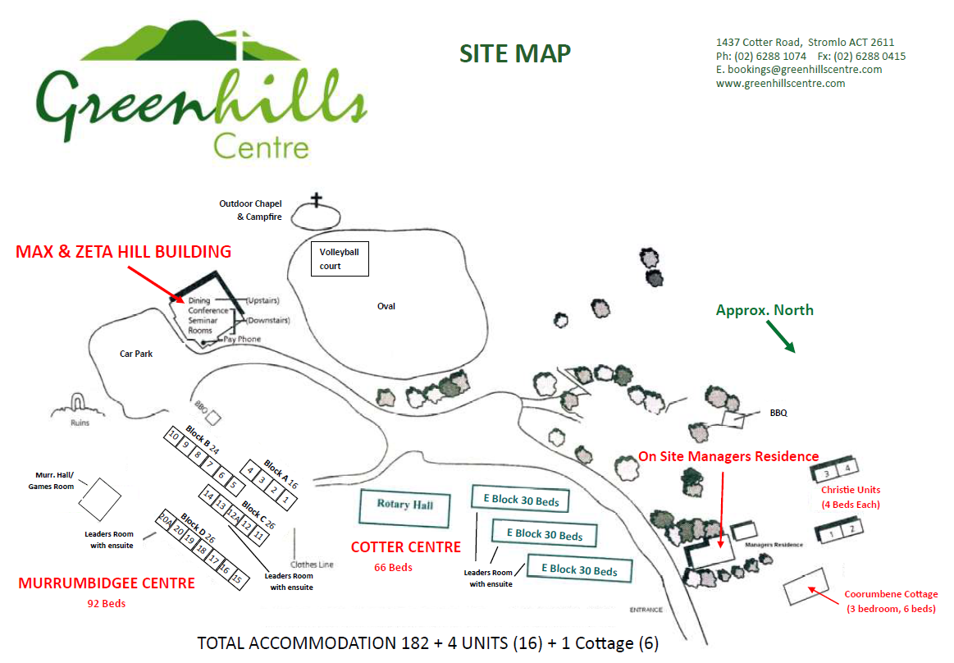
Camp Site
2016 Church Camp
Greenhills Centre
1437 Cotter Road, Stromlo ACT

Slide 5
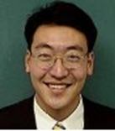
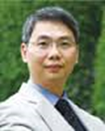
Guest Speakers
2016 Church Camp
Pastor Thomas Tokura
Chinese Christian Church Milson Point (Sydney)
梁國權先生
(中國神學研究院「生命之道」課程事工主任)

Slide 6
Contact
2016 Church Camp
Stephanie Leung

Slide 7

THE PEOPLE OF GOD
Save the dates!
More info and registration coming soon!

